Slide 1
RSHE
Wave 2 – Parent Meeting
Parents of Children in
Year 5 & Year 6
In September 2021

Slide 2
RELATIONSHIPS | SEX EDUCATION | HEALTH EDUCATION
COMPULSORY | COMPULSORY BY END OF KS2 | COMPULSORY
Age appropriate: Covers what a relationship is, and what is and is not acceptable | The National Curriculum for Science covers requires that the following are taught: a)main external body parts b) Human body changes from birth to old age c) Reproduction in plants and animals | Covers physical and mental wellbeing. Puberty, including menstruation should also be taught.
 | PARENTS CAN OPT OUT
 | Sex education beyond this is up to the policy of the school Gearies is not currently planning on teaching Human Reproduction.

Slide 3
What is Relationships Education?
What does the new Relationships Education cover?
Relationships Education in primary schools will cover
‘Families and people who care for me’,
‘Caring friendships’,
‘Respectful relationships’,
‘Online relationships’, and
‘Being safe’.
There is widespread agreement that children need to be able to recognise abusive behaviour and to know how to seek help if they are worried about abuse or experience it.
The new guidance states that by the end of primary school all children should know: ‘how to report concerns or abuse, and the vocabulary and confidence needed to do so’.

Slide 4
PSHE at Gearies
Personal Social Health Economic
The Framework has been formulated under the following headings:

Slide 9
Year 1

Slide 10
Year 2

Slide 19
What has changed and what has stayed the same?
The RSHE Guidance as well as advising and directing schools concerning RSHE, will always make reference to all other relevant laws and advice from The Government, including: the new Ofsted Inspection Framework, 2010 Equality Act, Keeping Children Safe in Education, SEND code of practice, and all other relevant guidance or statute
Primary schools can choose to teach about human reproduction, or not.
Parents have the right to withdraw their children from sex education.
Secondary schools still expected to teach about healthy relationships (mental, physical and emotional) and how to form healthy relationships, sex, STIs, consent, the law, pregnancy, contraception and parenting
Teaching is still expected to be age appropriate and must be respectful of the backgrounds of pupils
Generally, not much has changed.

Slide 20
So what are the other changes?
There will be more of a concentration on safeguarding and the use of the internet, in line with the expectation that RSHE will ready young people for life in 21st century Britain and guard against exploitation
Removal from classes (right of to withdraw) is only valid for sex education. Pupils are expected to attend any lessons containing only relationships content or sex education contained in the national curriculum for science.
GEARIES HAS CHOSEN NOT TO TEACH HUMAN REPRODUCTION in Year 5 & Year 6.
Issues faced by groups with protected status under the 2010 Equality Act, e.g. religious, disabled or LGBT+ groups, should be included in the curriculum in an age appropriate and integrated way, showing sensitivity to the various backgrounds that pupils come from

Slide 21
Sex Education in primary schools – not statutory, with a parental right of withdrawal
Sex education will not be compulsory in primary schools. However, the primary national curriculum for science already covers related areas, such as the main external body parts, puberty and reproduction in some plants and animals. It will be for primary schools to decide whether to cover any additional sex education content to meet their pupils’ needs.
The guidance recommends that primary school sex education programmes should be tailored to the age and maturity of pupils and that, through the science curriculum, both boys and girls should be prepared for puberty and know how a baby is conceived and born. Each school will be required to set out what additional sex education topics they will teach in a policy and consult with parents.

Slide 22
Statutory guidance
Relationships Education, Relationships and Sex Education (RSE) and Health Education
WHY?
Research has shown that good quality relationships and sex education can help to delay first sex, lower rates of teen pregnancy, reduce sexually transmitted infections (STIs) and make young people more likely to find help if they need it. *
Young people have said that they want high-quality RSE taught:
  more often and in a spiral curriculum
  by well trained, caring, teachers that can manage a class, are nonjudgmental, know the subjects well and will answer questions confidently and not get embarrassed (Sell 2019).
Many schools were not teaching RSHE adequately, or for only one day a year, and some not at all. (Sell 2019).
Good quality, age-appropriate RSHE can help to safeguard children and young people*
*Teenage Pregnancy Prevention Framework, 2018, Public Health England p 16
Notes:
Jo

Slide 23
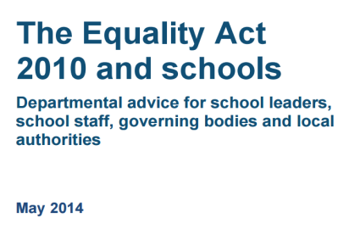
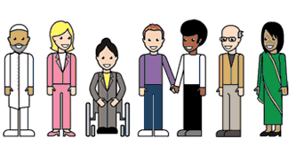
Inclusive Relationships, sex and health education is student-sensitive RSHE
1.9 It is unlawful for a school to discriminate against a pupil or prospective pupil by treating them less favourably because of their: sex, race, disability, religion or belief, sexual orientation, gender reassignment, pregnancy or maternity (DfE 2014, p8)
1.7 If a school treats bullying [against any of the groups outlined previously] less seriously … then it may be guilty of unlawful discrimination (DfE 2014, p8)

