Slide 1

Nursery Curriculum: Autumn Term One
“My World Your World”
“They both love looking at the stars.”
Principles of Curriculum Design
The curriculum must be rooted in values; driven by evidence: It is absolutely essential that this term focusses on establishing the Seven key features of effective practice (Development Matters) within all of our practice and provision:
The best for every child
High-quality care
The curriculum: what we want children to learn
Pedagogy: helping children to learn
Assessment: checking what children have learnt
Self-regulation and executive function
Partnership with parents
This must be achieved in a way that provides a clear understanding of expectations for all working in our Nursery. A shared understanding of the absolute essential principles and values of our work, both in this moment and moving forwards throughout the year.
The curriculum aspires to have an inclusive range of outcomes and definitions of success. Success will look like:
Children using descriptive language
Curious children who want to be noticed
Children who enjoy sharing books with adults
A creative and expressive community – singing and drawing freely
Children confident to express and share ideas and feelings.
The curriculum will be most effective when it is both intuitively delivered and internalised. (The “actual” curriculum) Foundational to the delivery of this curriculum is the maintaining of learning environments that are: active, concreate, multi-sensory and multimodal. These experiences will be planned and prepared effectively, delivered by using:
Our Curriculum Progression Planning maps and Topic Webs
Development Matters – “Birth to three – babies, toddlers and young children will be learning to” progression maps
The curriculum must be responsive to our children’s needs, practical, reflective and driven by professional learning and development. Those delivering it must be able to describe, explain and justify it. Professional Learning will focus on:
Operational elements of Possibility Thinking and Pedagogy – (Cremin, Burnard, Craft)
Attachment, Attunement, Professional Love ( Thomas Corum)
“Starting with a child” – (Bissex, GNYS AT WRK)
Parental partnership must form part of curriculum delivery:
Stay and Play/Summer Kindergarten Project.
Areas | The Big Concepts:
CL | Can the child use around 300 words? - can the child show that they understand action words by pointing to the right picture in a book. These words include descriptive language. They include words for time, space (for example, ‘over there’) and function (for example, they can tell you a sponge is for washing). Is the child linking up to 5 words together? Is the child using pronouns (‘me’, ‘him’, ‘she’), and using plurals and prepositions (‘in’, ‘on’, ‘under’) Can the child follow instructions with three key words.
PSED | Becoming increasingly curious about their world and wanting to explore it and be noticed - the child starts to see themselves as a separate person, they decide what to play with, what to eat, what to wear. The child starts to enjoy the company of other children and will want to play with them.
PD | Developing their core muscles. Show attention to sounds and music. Respond emotionally and physically to music when it changes.
Literacy | Enjoy sharing books with an adult - Pay attention and respond to the pictures or the words. Have favourite books and seek them out, to share with an adult, with another child, or to look at alone. Enjoy drawing freely. Enjoy songs and rhymes, tuning in and paying attention
Maths | Develop counting-like behaviour, such as making sounds, pointing or saying some numbers in sequence. Notice patterns and arrange things in patterns.
UTW | Make connections between the features of their family and other families. Notice differences between people.
EAD | Start to make marks intentionally. Explore paint, using fingers and other parts of their bodies as well as brushes and other tools. Express ideas and feelings through making marks, and sometimes give a meaning to the marks they make.

Slide 2

Nursery Curriculum: Autumn Term Two
“Let’s Celebrate”
“Ride the wind and drift east”
Areas | The Big Concepts:
CL | Can the child use around 300 words? - can the child show that they understand action words by pointing to the right picture in a book. These words include descriptive language. They include words for time, space (for example, ‘over there’) and function (for example, they can tell you a sponge is for washing). Is the child linking up to 5 words together? Is the child using pronouns (‘me’, ‘him’, ‘she’), and using plurals and prepositions (‘in’, ‘on’, ‘under’) Can the child follow instructions with three key words.
PSED | Becoming increasingly curious about their world and wanting to explore it and be noticed - the child starts to see themselves as a separate person, they decide what to play with, what to eat, what to wear. The child starts to enjoy the company of other children and will want to play with them. Play with increasing confidence on their own and with other children, because they know their key person is nearby and available. Express preferences and decisions. They also try new things and start establishing their autonomy.
PD | Developing their core muscles.- gaining control of their whole body through continual practice of large movements, such as waving, kicking, rolling, crawling and walking.
Literacy | Have favourite books and seek them out, to share with an adult, with another child, or to look at alone. Repeat words and phrases from familiar stories. Ask questions about the book. Make comments and shares their own ideas. Develop play around favourite stories using props. Add some marks to their drawings, which they give meaning to.
Maths | Develop counting-like behaviour, such as making sounds, pointing or saying some numbers in sequence. Notice patterns and arrange things in patterns. Compare amounts, saying ‘lots’, ‘more’ or ‘same’. Count in everyday contexts, sometimes skipping numbers – ‘1-2-3-5’.
UTW | Explore natural materials, indoors and outside. Explore and respond to different natural phenomena
EAD | Explore different materials, using all their senses to investigate them. Manipulate and play with different materials. Use their imagination as they consider what they can do with different materials Introduce children to a broad selection of action songs from different cultures and languages.
Principles of Curriculum Design
The curriculum must be rooted in values; driven by evidence: It is absolutely essential that this term focusses on establishing the Seven key features of effective practice (Development Matters) within all of our practice and provision:
The best for every child
High-quality care
The curriculum: what we want children to learn
Pedagogy: helping children to learn
Assessment: checking what children have learnt
Self-regulation and executive function
Partnership with parents
This must be achieved in a way that provides a clear understanding of expectations for all working in our Nursery. A shared understanding of the absolute essential principles and values of our work, both in this moment and moving forwards throughout the year.
The curriculum aspires to have an inclusive range of outcomes and definitions of success. Success will look like:
Children enjoy engaging, with supportive adults in experiences of Possibility Thinking
Posing questions: posed aloud, or implied through actions
Play: guided by supportive, participating adults over extended periods of time
Immersion: in a professional loving environment
Innovation: strong playful connections between ideas, guided by adults
Imaginative: as deep and agentive involvement is encouraged.
The curriculum will be most effective when it is both intuitively delivered and internalised. (The “actual” curriculum) Foundational to the delivery of this curriculum is the maintaining of learning environments that are: active, concreate, multi-sensory and multimodal. These experiences will be planned and prepared effectively, delivered by using:
Our Curriculum Progression Planning maps and Topic Webs
Development Matters – “Birth to three – babies, toddlers and young children will be learning to” progression maps
The curriculum must be responsive to our children’s needs, practical, reflective and driven by professional learning and development. Those delivering it must be able to describe, explain and justify it. Professional Learning will focus on:
Operational elements of Possibility Thinking and Pedagogy – (Cremin, Burnard, Craft)
Attachment, Attunement, Professional Love ( Thomas Corum)
“Starting with a child” – (Bissex, GNYS AT WRK)
Parental partnership must form part of curriculum delivery:
Parents Network
Soft opening and end of day protected times for parents and primary carers to meet with members of our team.

Slide 3

Nursery Curriculum: Spring Term One
“A Winter Wonderland”
“"The colour of springtime is in the flowers, the colour of winter is in the imagination.”
Areas | The Big Concepts:
CL | Our children use a wider range of vocabulary. We extend our children’s vocabulary, explaining unfamiliar words and concepts and making sure children have understood what they mean through stories and other activities. These should include words and concepts which occur frequently in books and other contexts but are not used every day by many young children.
PSED | We respond to children’s increasing independence and sense of responsibility. We increase the range of resources and challenges, outdoors and inside, widening the range of activities that children feel confident to take part in.
PD | Encourage children to transfer physical skills learnt in one context to another one.
Literacy | Understand the five key concepts about print: Print has meaning Print can have different purposes We read English text from left to right and from top to bottom The names of the different parts of a book Page sequencing Develop their phonological awareness, so that they can: spot and suggest rhymes count or clap syllables in a word recognise words with the same initial sound Engage in extended conversations about stories, learning new vocabulary
Maths | Develop fast recognition of up to 3 objects, without having to count them individually (‘subitising’). Recite numbers past 5. Talk about and explore 2D and 3D shape
UTW | Use all their senses in hands-on exploration of natural materials. Exploring collections of materials with similar and/or different properties. Our children talk about what they see, using a wide vocabulary. Our children continue developing positive attitudes about the differences between people
EAD | Our children take part in simple pretend play. Begin to develop complex stories using small world equipment. Make imaginative and complex ‘small worlds’ with blocks and construction kits. Our children explore different materials freely, to develop their ideas about how to use them and what to make. Join in with songs and rhymes, making some sounds. Make rhythmical and repetitive sounds. Explore a range of soundmakers and instruments and play them in different ways.
Principles of Curriculum Design
The curriculum must be rooted in values; driven by evidence: Whilst maintaining process made towards establishing practice and provision rooted towards the Seven Principles, now with Attachments and Attunemnts strong, our provision will build on Autumn Term Two’s early work on Possibility Thinking - by embedding the pedagogical themes related to the practices: ‘standing back’, profiling learner agency and creating time and space for high quality interactions. Possibility thinking, supported by an enabling context, encompasses a number of core features, including: the posing of questions, play, immersion, innovation, risk taking, being imaginative, self determination and intentionality (Burnard et al., 2006).
This is also a time when we will self review our effectiveness in ceating a curriculum that fosters the three characteristics of effective teaching and learning:
• playing and exploring – children investigate and experience things, and ‘have a go’
• active learning – children concentrate and keep on trying if they encounter difficulties, and enjoy achievements
• creating and thinking critically – children have and develop their own ideas, make links between ideas, and develop strategies for doing things
The curriculum aspires to have an inclusive range of outcomes and definitions of success. Success will look like:
Children enjoy engaging, with supportive adults in experiences of Possibility Thinking.
Posing questions: posed aloud, or implied through actions
Play: guided by supportive, participating adults over extended periods of time
Immersion: in a professional loving environment
Innovation: strong playful connections between ideas, guided by adults
Imaginative: as deep and agentive involvement is encouraged.
The curriculum will be most effective when it is both intuitively delivered and internalised. (The “actual” curriculum) Foundational to the delivery of this curriculum is the maintaining of learning environments that are: active, concreate, multi-sensory and multimodal. These experiences will be planned and prepared effectively, delivered by using:
Our Curriculum Progression Planning maps and Topic Webs
Development Matters – “3 and 4-year-olds will be learning to”
The curriculum must be responsive to our children’s needs, practical, reflective and driven by professional learning and development. Those delivering it must be able to describe, explain and justify it. Professional Learning will focus on:
Operational elements of Possibility Thinking and Pedagogy – (Cremin, Burnard, Craft)
Attachment, Attunement, Professional Love ( Thomas Corum)
“Starting with a child” – (Bissex, GNYS AT WRK)
Parental partnership must form part of curriculum delivery:
Parents Network
Soft opening and end of day protected times for parents and primary carers to meet with members of our team.

Slide 4
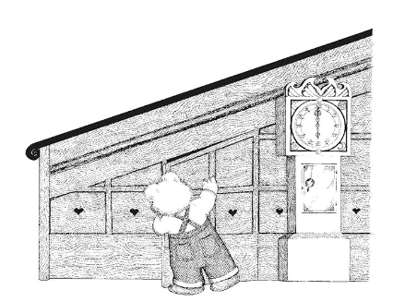
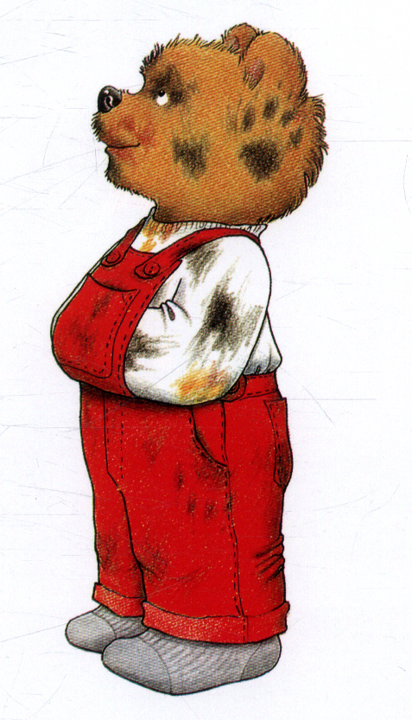
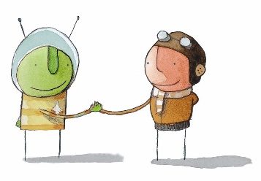

Nursery Curriculum: Spring Term Two
“Wheels, wings and other things”
“ The moon and back before bedtime? Whatever next?”
Areas | The Big Concepts:
CL | Our children use a wider range of vocabulary. We extend our children’s vocabulary, explaining unfamiliar words and concepts and making sure children have understood what they mean through stories and other activities. These should include words and concepts which occur frequently in books and other contexts but are not used every day by many young children.
PSED | We respond to children’s increasing independence and sense of responsibility. We increase the range of resources and challenges, outdoors and inside, widening the range of activities that children feel confident to take part in.
PD | Continue to develop their movement, balancing, riding (scooters, trikes and bikes)
Literacy | Understand the five key concepts about print: Print has meaning Print can have different purposes We read English text from left to right and from top to bottom The names of the different parts of a book Page sequencing Develop their phonological awareness, so that they can: spot and suggest rhymes count or clap syllables in a word recognise words with the same initial sound Engage in extended conversations about stories, learning new vocabulary
Maths | To secure a fast recognition of up to 3 objects, without having to count them individually (‘subitising’). Linking numerals and amounts: for example, showing the right number of objects to match the numeral, up to 5. Make comparisons between objects relating to size, length, weight and capacity. Discuss routes and locations, using words like ‘in front of’ and ‘behind’.
UTW | Our children continue developing positive attitudes about the differences between people, showing interest in different occupations. Our children will explore and respond to different natural phenomena in their setting and on trips.
EAD | Our children make imaginative and complex ‘small worlds’ with blocks and construction kits. Our children draw with increasing complexity and detail. They develop their own ideas and then decide which materials to use to express them.
Principles of Curriculum Design
The curriculum must be rooted in values; driven by evidence: Whilst maintaining process made towards establishing practice and provision rooted towards the Seven Principles, now with Attachments and Attunemnts strong, our provision will build on our work around Possibility Thinking - by embedding the pedagogical themes related to the practices: ‘standing back’, profiling learner agency and creating time and space for high quality interactions. Possibility thinking, supported by an enabling context, encompasses a number of core features, including: the posing of questions, play, immersion, innovation, risk taking, being imaginative, self determination and intentionality (Burnard et al., 2006).
This is also a time when we will self review our effectiveness in creating a curriculum that fosters the three characteristics of effective teaching and learning:
• playing and exploring – children investigate and experience things, and ‘have a go’
• active learning – children concentrate and keep on trying if they encounter difficulties, and enjoy achievements
• creating and thinking critically – children have and develop their own ideas, make links between ideas, and develop strategies for doing things
The curriculum aspires to have an inclusive range of outcomes and definitions of success. Success will look like:
Children enjoy engaging, with supportive adults in experiences of Possibility Thinking.
Posing questions: posed aloud, or implied through actions
Play: guided by supportive, participating adults over extended periods of time
Immersion: in a professional loving environment
Innovation: strong playful connections between ideas, guided by adults
Imaginative: as deep and agentive involvement is encouraged.
The curriculum will be most effective when it is both intuitively delivered and internalised. (The “actual” curriculum) Foundational to the delivery of this curriculum is the maintaining of learning environments that are: active, concreate, multi-sensory and multimodal. These experiences will be planned and prepared effectively, delivered by using:
Our Curriculum Progression Planning maps and Topic Webs
Development Matters – “3 and 4-year-olds will be learning to”
The curriculum must be responsive to our children’s needs, practical, reflective and driven by professional learning and development. Those delivering it must be able to describe, explain and justify it. Professional Learning will focus on:
Operational elements of Possibility Thinking and Pedagogy – (Cremin, Burnard, Craft)
Attachment, Attunement, Professional Love ( Thomas Corum)
“Starting with a child” – (Bissex, GNYS AT WRK)
Parental partnership must form part of curriculum delivery:
- Parents network
Soft opening and end of day protected times for parents and primary carers to meet with members of our team.

Slide 5
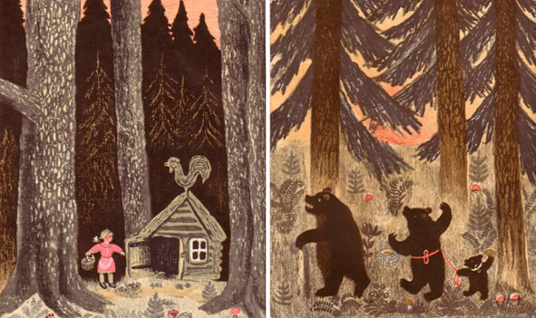
Nursery Curriculum: Summer Term One
“Terrific Tales”
“ Once upon a time”
Principles of Curriculum Design
The curriculum must be rooted in values; driven by evidence: With strong attachments secured, Our Seven Principles and Three Characteristics established throughout practice and provision, focus now looks at evaluating and improving the quality of the child and adult interactions being experienced through moments of Possibility Thinking . In this term Professional enhancement centres on understanding: “Sustained shared thinking” which occurs when two or more individuals “work together” in an intellectual way to solve a problem, clarify a concept, evaluate an activity, extend a narrative etc.
The curriculum aspires to have an inclusive range of outcomes and definitions of success.
Success will look like:
High quality child and adult interactions through which both parties are contributing to the thinking, experiences that develop and extend understanding. Occurring when children are interacting 1:1 with an adult or with a single peer partner and/ or during focussed group work.
The curriculum will be most effective when it is both intuitively delivered and internalised. (The “actual” curriculum) Foundational to the delivery of this curriculum is the maintaining of learning environments that are: active, concreate, multi-sensory and multimodal. These experiences will be planned and prepared effectively, delivered by using:
Our Curriculum Progression Planning maps and Topic Webs
Development Matters – “3 and 4-year-olds will be learning to”
The curriculum must be responsive to our children’s needs, practical, reflective and driven by professional learning and development. Those delivering it must be able to describe, explain and justify it. Professional Learning will focus on:
Operational elements of Possibility Thinking and Pedagogy – (Cremin, Burnard, Craft)
Attachment, Attunement, Professional Love ( Thomas Corum)
“Starting with a child” – (Bissex, GNYS AT WRK)
The Effective Provision of Pre-School Education (EPPE) Project (2004)
Parental partnership must form part of curriculum delivery:
Parents Network
Summer Kindergarten
Stay and Play Project
Soft opening and end of day protected times for parents and primary carers to meet with members of our team.
Areas | The Big Concepts:
CL | To enjoy listening to longer stories and can remember much of what happens. Make imaginative and complex plays, responding to what they have heard, expressing their thoughts and feelings.
PSED | Play with one or more other children, extending and elaborating play ideas. Finding solutions to conflicts and rivalries.
PD | Choose the right resources to carry out their own plan. Use one-handed tools and equipment,
Literacy | Engage in extended conversations about stories, learning new vocabulary. Our children will use some of their print and letter knowledge in their early writing.
Maths | Make comparisons between objects relating to size, length, weight and capacity.
UTW | Know that there are different countries in the world and talk about the differences they have experienced or seen in photos. Plant seeds and care for growing plants. Understanding the need to respect and care for the natural environment and all living things.
EAD | Remember and sing entire songs. Sing the pitch of a tone sung by another person (‘pitch match’). Sing the melodic shape (moving melody, such as up and down, down and up) of familiar songs. Create their own songs or improvise a song around one they know.

Slide 6

Nursery Curriculum: Summer Term Two
“Sun, Sea and Sand/ We speak of starting with a child”
”There is no other place we can start from”
Principles of Curriculum Design
The curriculum must be rooted in values; driven by evidence: With strong attachments secured, Our Seven Principles and Three Characteristics established throughout practice and provision, focus now looks at evaluating and improving the quality of the child and adult interactions being experienced through moments of Possibility Thinking . In this term Professional enhancement centres on understanding: “Sustained shared thinking” which occurs when two or more individuals “work together” in an intellectual way to solve a problem, clarify a concept, evaluate an activity, extend a narrative etc.
In this term we will also support our parents and children prepare for transition to Reception through our Kindergarten and Stay and Play projects – with an ethos that “At school as well as at home, the most effective talking and learning will take place when adult and child engage together collaboratively in the negotiation of meaning.” (Wells, G, 1988)
The curriculum aspires to have an inclusive range of outcomes and definitions of success. Success will look like: Effective preparation for Transition that starts with the child’s needs, “We speak of starting with a child, “where he is” which in one sense is not to assert an educational desideratum but an inescapable fact; there is no other place the child can start from. There are only other placers the educator can start from” (Bissex, GNYS AT WRK, 980 p. 111). Transition should be viewed as a process, not as an event, and therefore should be planned for and discussed with Leaders, Teachers, Practitioners, children and parents throughout the year. Our structure ensures children’s well-being is a priority, protecting time for communication, relationships and meaningful learning, assessment and evaluation to be shared by and with all stakeholders. It is the intention of our structure to ensure time for all stakeholders, including parents, to: Ensure shared ownership of the process,; Engage in shared thinking and professional development; Involve parents meaningfully in the children’s journey; Approach teaching and learning with creativity; Review staffing structures and provision; Audit resources, environments and provision; Engage in shared data analysis and evaluation; Ensure core values underpin actions; Ensure our learners are ready.
The curriculum will be most effective when it is both intuitively delivered and internalised. (The “actual” curriculum) Foundational to the delivery of this curriculum is the maintaining of learning environments that are: active, concreate, multi-sensory and multimodal. These experiences will be planned and prepared effectively, delivered by using:
Our Curriculum Progression Planning maps and Topic Webs
Development Matters – “3 and 4-year-olds will be learning to”/ “Children in reception will be learning to”
The curriculum must be responsive to our children’s needs, practical, reflective and driven by professional learning and development. Those delivering it must be able to describe, explain and justify it. Professional Learning will focus on:
Operational elements of Possibility Thinking and Pedagogy – (Cremin, Burnard, Craft)
Attachment, Attunement, Professional Love ( Thomas Corum)
“Starting with a child” – (Bissex, GNYS AT WRK)
The Effective Provision of Pre-School Education (EPPE) Project (2004)
An Affective Pedagogy (Rogers, S)
Parental partnership must form part of curriculum delivery:
Parents Network
Summer Kindergarten
Stay and Play Project
Soft opening and end of day protected times for parents and primary carers to meet with members of our team.
Areas | The Big Concepts:
CL | Be able to express a point of view and to debate when they disagree with an adult or a friend, using words as well as actions. Start a conversation with an adult or a friend and continue it for many turns. Use talk to organise themselves and their play
PSED | Be increasingly independent in meeting their own care needs, Talk about their feelings using words like ‘happy’, ‘sad’, ‘angry’ or ‘worried’ and understand gradually how others might be feeling.
PD | Choose the right resources to carry out their own plan. For example, choosing a spade to enlarge a small hole they dug with a trowel. Collaborate with others to manage large items, such as moving a long plank safely, carrying large hollow blocks Use large and small motor skills to do things independently, for example manage buttons and zips, and pouring when exploring water based play
Literacy | Engage in extended conversations about stories, learning new vocabulary. Our children will use some of their print and letter knowledge in their early writing.
Maths | Experiment with their own symbols and marks as well as numerals. Solve real world mathematical problems with numbers up to 5. Compare quantities using language: ‘more than’, ‘fewer than’.
UTW | Know that there are different countries in the world and talk about the differences they have experienced or seen in photos.
EAD | Explore different materials freely, to develop their ideas about how to use them and what to make. Develop their own ideas and then decide which materials to use to express them. Join different materials and explore different textures.

